Slide 1
BOOLEAN ALGEBRA

Slide 2
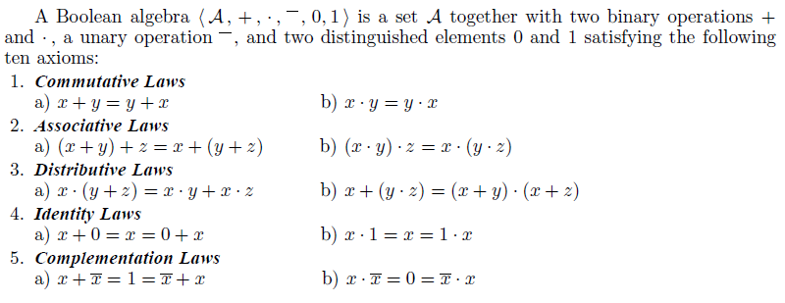

Slide 3
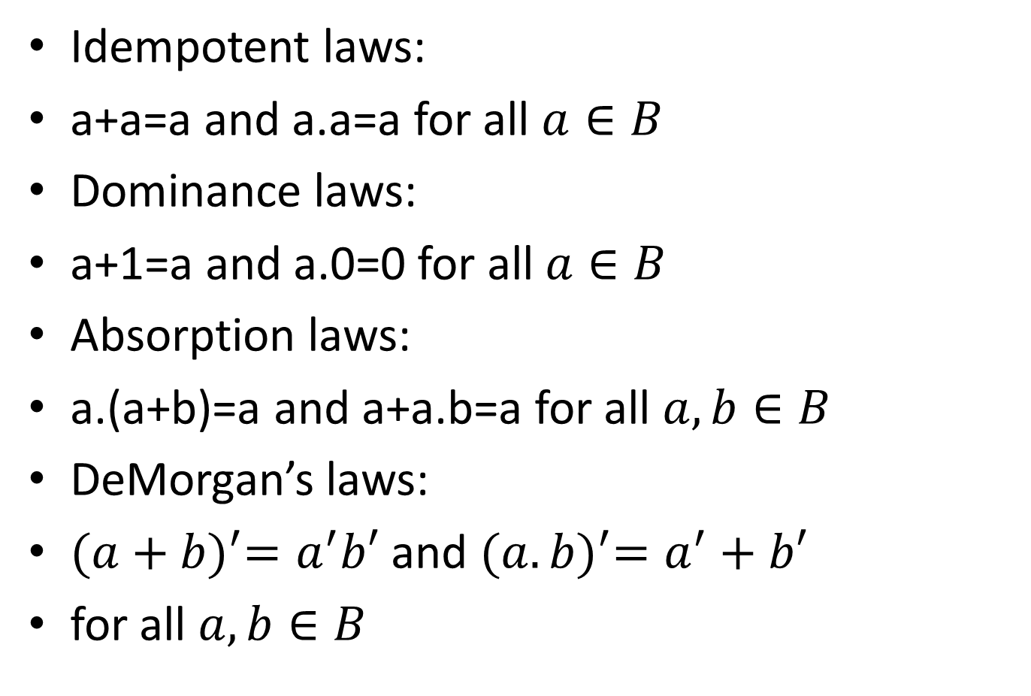
Additional properties of Boolean algebra
Idempotent laws:
a+a=a and a.a=a for all $a∈B$
Dominance laws:
a+1=a and a.0=0 for all $a∈B$
Absorption laws:
a.(a+b)=a and a+a.b=a for all $a, b∈B$
DeMorgan’s laws:
${(a+b)}^{′}=a^{′}b′$ and ${(a.b)}^{′}=a^{′}+b′$
for all $a, b∈B$

Slide 4
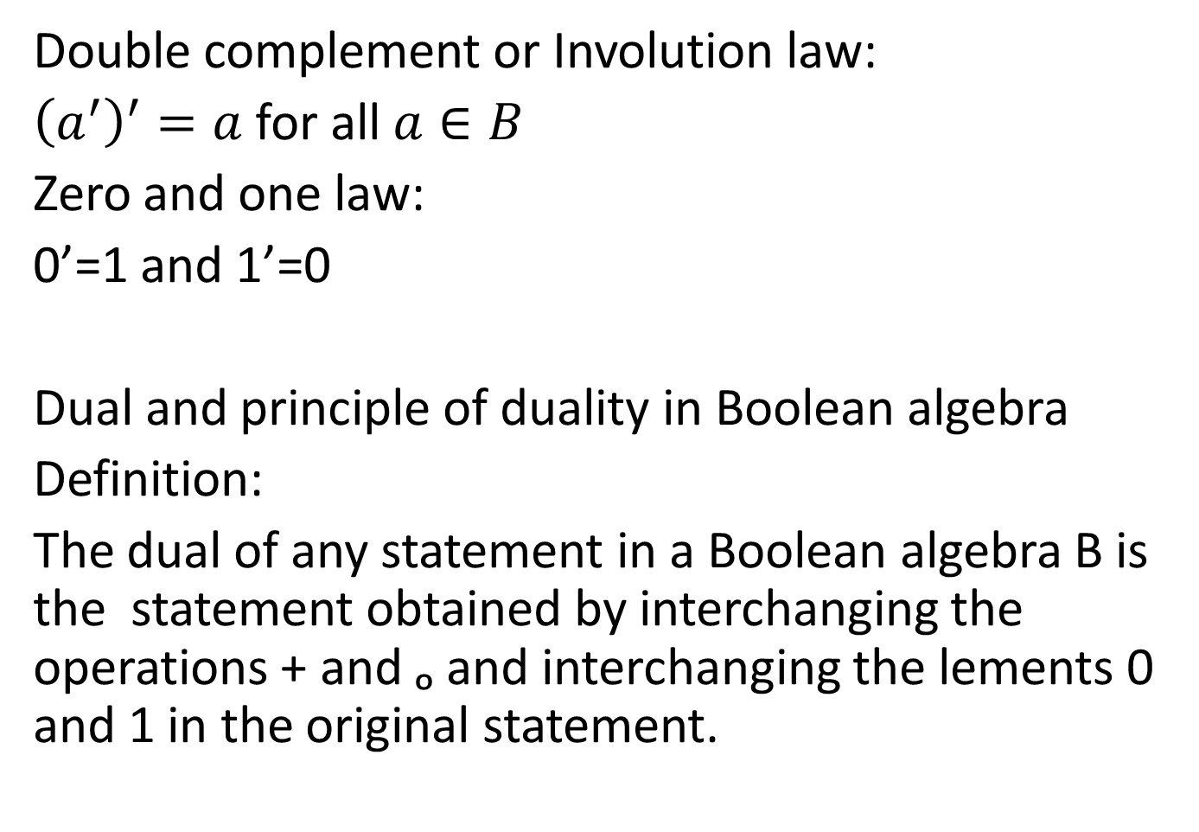
Double complement or Involution law:
${\left(a^{′}\right)}^{′}=a$for all $a∈B$
Zero and one law:
0’=1 and 1’=0
Dual and principle of duality in Boolean algebra
Definition:
The dual of any statement in a Boolean algebra B is the statement obtained by interchanging the operations + and ₒ and interchanging the lements 0 and 1 in the original statement.

Slide 5
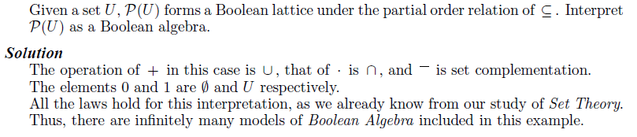

Slide 6
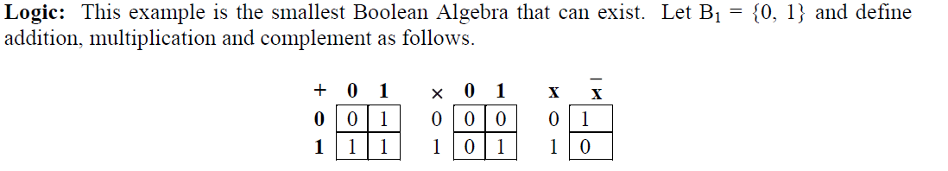

Slide 7
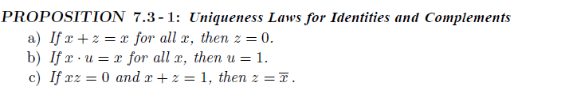
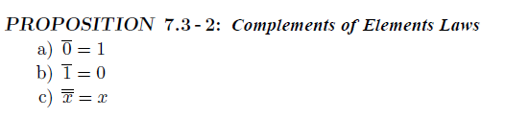

Slide 8
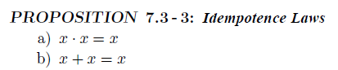
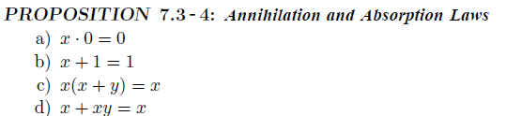
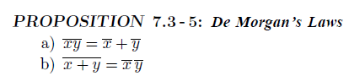

Slide 9
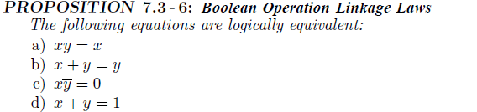
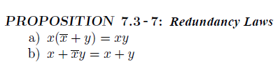
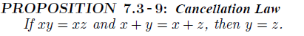

Slide 10
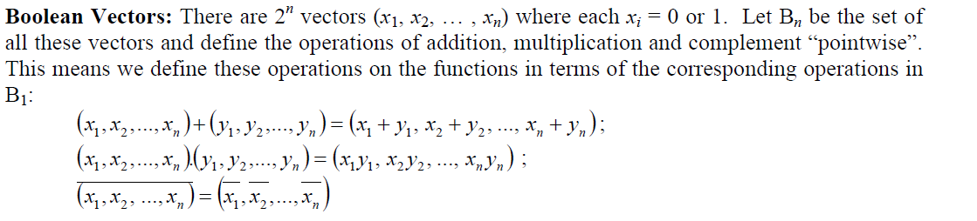

Slide 11
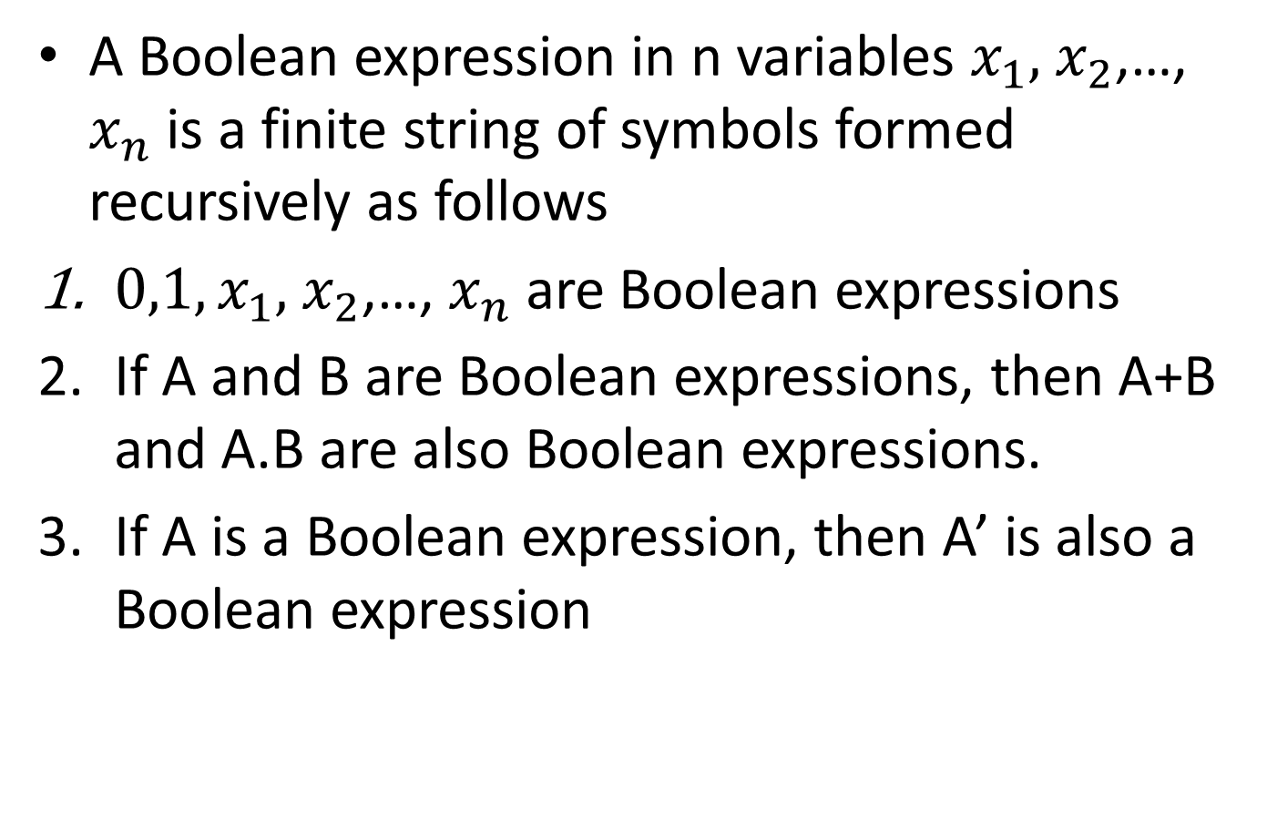
Boolean expression
A Boolean expression in n variables $x_{1},$ $x_{2}$,…, $x_{n}$ is a finite string of symbols formed recursively as follows
${0,1,x}_{1},$ $x_{2}$,…, $x_{n}$ are Boolean expressions
If A and B are Boolean expressions, then A+B and A.B are also Boolean expressions.
If A is a Boolean expression, then A’ is also a Boolean expression

Slide 12
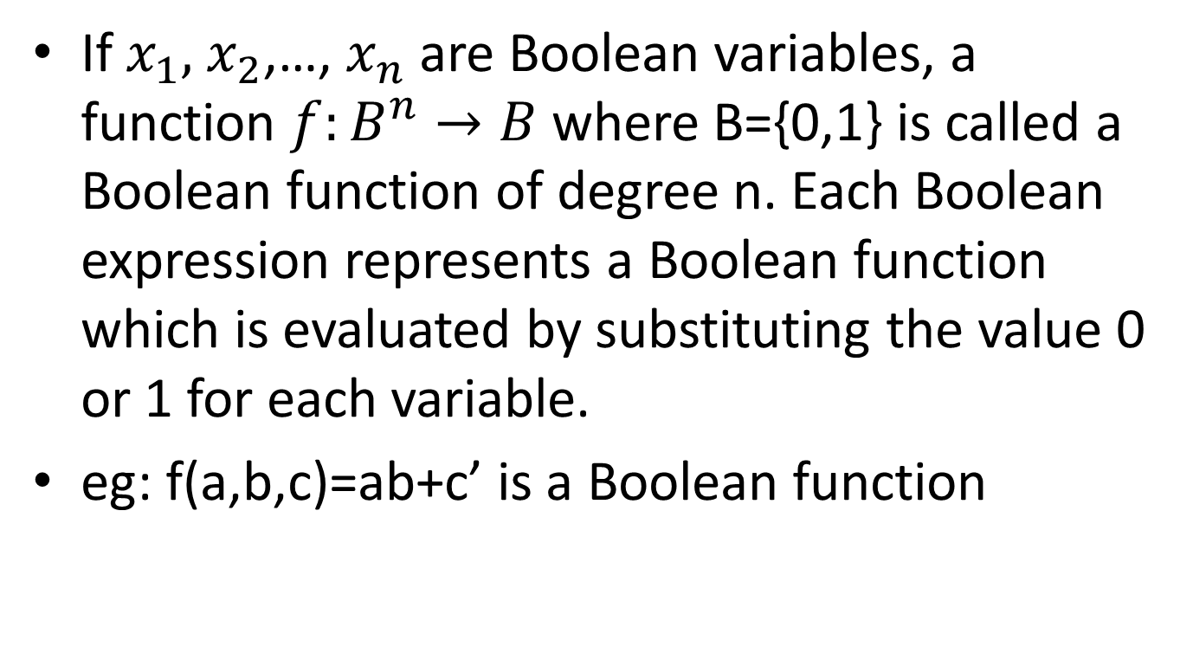
Boolean function
If $x_{1},$ $x_{2}$,…, $x_{n}$ are Boolean variables, a function $f:B^{n}→B$ where B={0,1} is called a Boolean function of degree n. Each Boolean expression represents a Boolean function which is evaluated by substituting the value 0 or 1 for each variable.
eg: f(a,b,c)=ab+c’ is a Boolean function

Slide 13
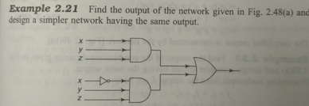

Slide 14
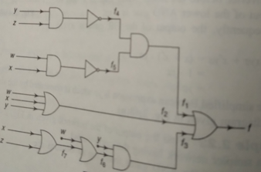
Find the output of the following combinatorial circuit and and design a simpler circuit.

Slide 15
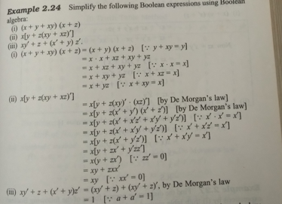

Slide 17
Find the disjunctive normal forms of the following Boolean expressions by (i) truth table method (ii) algebraic method
Solution:
a)f(x,y,z)=xy+yz’
b)f(x,y,z)=y’+[z’+x+(yz)’](z+x’y)
c)f(x,y,z,w)=xy+yzw’

Slide 22
Find the conjunctive normal forms of the following Boolean expressions using (i)truth table method and (ii) algebraic method
a)f(x,y,z)=(x+z)y
b)f(x,y,z)=x
c)f(x,y,z)=(yz+xz’)(xy’+z)’

Slide 23
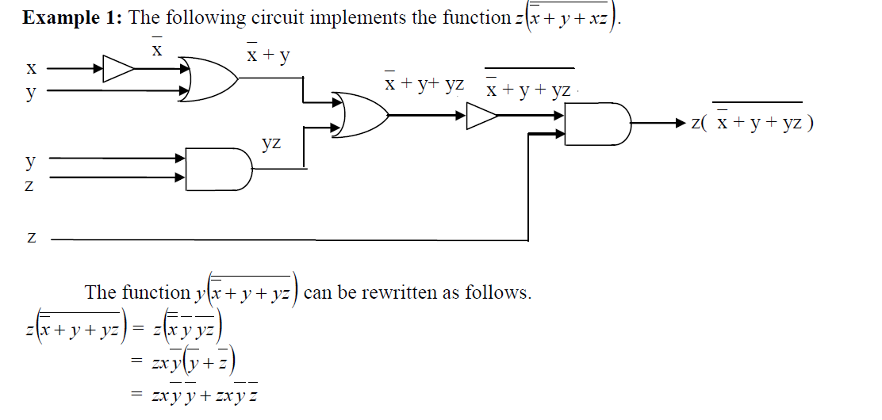
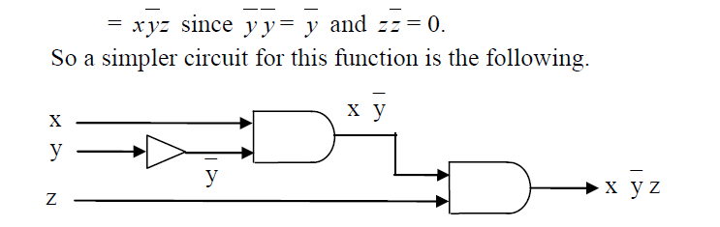

Slide 24
